Slide 1

NATIONAL POLICY ANALYSIS
GROUP PRESENTATION
NATIONAL POLICY ON
BIOFUELS
(Ministry of New & Renewable Energy)
LET’SSTART

Slide 2
GROUP MEMBERS
Jitendra Kumar Tiwari
Indian Revenue Services – C&CE
Avneet Kaur
Indian Statistical Services
Gyanendra Pratap Singh
Indian Statistical Services
Shreya Sengupta
Indian Statistical Services
Indradeep Roy Chowdhury
Indian Statistical Services
Rambabu Vavilapalli
Indian Railway Traffic Services
Sri Selvam C.
Indian Forest Services
Kanchan Garg
Indian Revenue Services – IT
Anannya Saikia
Indian Corporate Law Services
Saurabh Singh
Indian Statistical Services
Akashdeep
Indian Revenue Services – IT

Slide 3

WHAT ARE BIOFUELS?
BIOFUELS are liquid or gaseous fuels produced from biomass resources and used in place of, or in addition to, diesel, petrol or other fossil fuels for transport, stationary, portable and other applications.
CATEGORIES
  First generation biofuels (Bioalcohols, Biodiesel, Vegetable oil, Bioethers, Biogas)
  Second generation biofuels (advanced biofuels like biohydrogen, biomethanol)
  Third generation biofuels (micro-organisms like algae)

Slide 4
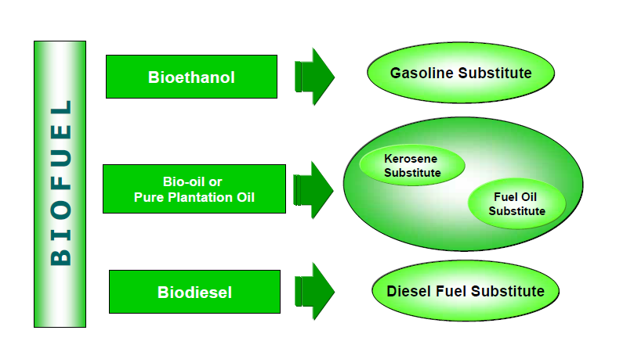
WHAT ARE BIOFUELS?

Slide 5
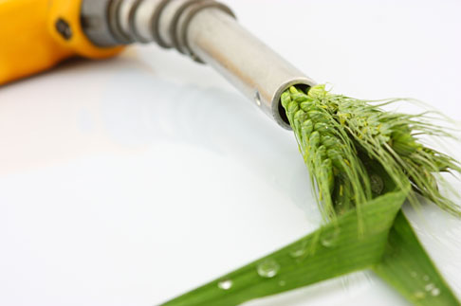
INDIA’S BIOFUEL POLICY
Approved on: 24-12-2009
Ministry of New & Renewable Energy
MAIN PURPOSE:
  Strengthen India’s energy security
  Ensure availability of minimum level of biofuels
  Meet the energy needs of rural population
  Stimulate rural development and create employment opportunities.
  Thrust for innovation, research and development
  Minimum Support Price (MSP) mechanism
  Setup institutional mechanism for Biofuel
Notes:
Responsible Ministry:- Ministry of New & Renewable Energy
Approved on :- 24-12-2009
Main purpose of the Policy:-
Strengthen India’s energy security by encouraging use of renewable energy resources.
To ensure that a minimum level of biofuels become readily available in the market to meet the demand at any given time.
Meet the energy needs of a vast rural population as well as stimulate rural development and create employment opportunities.
A thrust for innovation, (multi-institutional, indigenous and time bound) on research and development of bio-fuel feedstock production, including second generation biofuels.
Minimum Support Price (MSP) mechanism to ensure a fair price for bio-diesel oilseed growers.
To setup institutional mechanism for Biofuel.

Slide 6
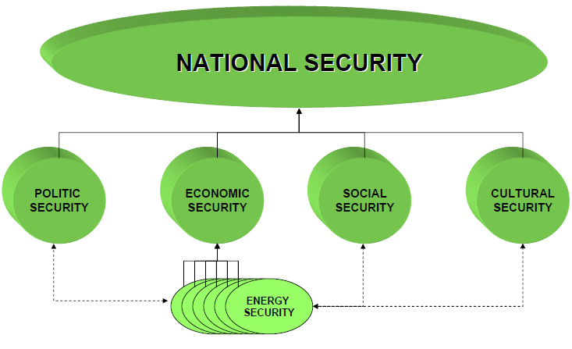
INDIA’S BIOFUEL POLICY
Notes:
Responsible Ministry:- Ministry of New & Renewable Energy
Approved on :- 24-12-2009
Main purpose of the Policy:-
Strengthen India’s energy security by encouraging use of renewable energy resources.
To ensure that a minimum level of biofuels become readily available in the market to meet the demand at any given time.
Meet the energy needs of a vast rural population as well as stimulate rural development and create employment opportunities.
A thrust for innovation, (multi-institutional, indigenous and time bound) on research and development of bio-fuel feedstock production, including second generation biofuels.
Minimum Support Price (MSP) mechanism to ensure a fair price for bio-diesel oilseed growers.
To setup institutional mechanism for Biofuel.

Slide 7
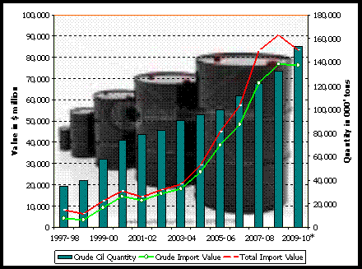
WHY DO WE NEED A BIOFUEL POLICY?
INDIA with its growing population and rapid socio-economic development
4
5
6
Fourth largest petroleum consumer in the world
Fifth largest primary energy consumer in the world
Sixth energy demand in world
26% demand satisfied only
On-road vehicle population has increased from 49 million to more than 65 million vehicles over the last five years and is expected to grow annually by 8 to 10 per cent
Serious concerns for the environment (India is the world’s FOURTH largest contributor to carbon emissions)
Import of Crude Oil and Value of Petroleum Products
Consumption of Petroleum Products
Notes:
India ranks sixth in the world in terms of energy demand, and domestic production of crude oil only satisfies about 25 per cent of this requirement.
India is the fifth largest primary energy consumer and fourth largest petroleum consumer in the world.
Growing population and rapid socio-economic development.
India’s on-road vehicle population has increased from 49 million to more than 65 million vehicles over the last five years and is expected to grow annually by 8 to 10 per cent.
Serious concerns for the environment (India is the world’s fourth largest contributor to carbon emissions).

Slide 8
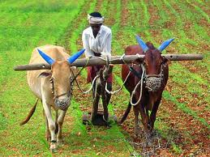

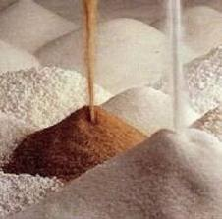

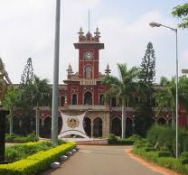
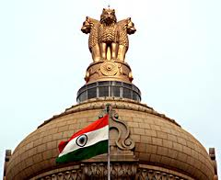
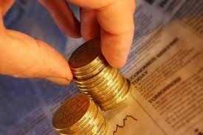

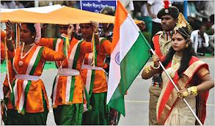
WHO ARE THE STAKEHOLDERS?
Farmers and growers of non-edible oilseed
Cooperatives and Self-Help Groups
Sugar, textiles, paper mills and other SMEs
Oil marketing companies, automobile industry
Research institutions, forestry departments, universities, NABARD
Various union ministries, State governments
Commercial banks
Foreign Investors
All citizens and residents of India

Slide 9

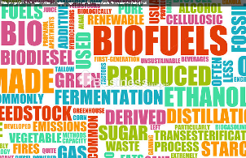
KEY ELEMENTS OF THE POLICY
Establishment of a National Biofuel Coordination Committee under the Prime Minister
Set up of a National Biofuel Steering Committee (NBSC) to provide policy guidelines
Indicative target of 20% by 2017 for the blending of biofuels – bioethanol and bio-diesel
Envisage development of next-generation, more efficient biofuel conversion technologies based on new feed stocks
Minimum Support Price (MSP) mechanism to ensure a fair price for bio-diesel oilseed growers
Minimum Purchase Price (MPP) for the purchase of bio-ethanol by the Oil Marketing Companies (OMCs)
Bio-diesel production to be taken up from non-edible oil seeds in waste / degraded / marginal lands
NATIONAL POLICY ON BIOFUELS

Slide 10

MERITS
Policy gives due consideration to aspect of food security – promotes production of non food feedstock only
Use of waste /degraded / marginal lands for cultivation
In a direction to meet the energy needs of vast rural population and to create employment opportunities
Involvement of local communities in decision making process
Financial incentives and credit facilities - Provision of MSP and MPP
A thrust for innovation, (multi-institutional, indigenous and time bound) on research and development of bio-fuel feedstock production, including second generation bio fuels
Merits of the Policy:
    OPTIMAL DEVELOPMENT & UTILIZATION
    USE OF WASTE DEGRADED LAND
    FINANCIAL & CREDIT INCENTIVES
    LOCAL COMMUNITY INVOLVEMENT
    RURAL DEVELOPMENT – ENERGY NEEDS & EMPLOYMENT
    INNOVATION

Slide 11
DEMERITS
Advanced bio fuels in India are still at the research stage and it will take time before commercial production becomes economically viable
Wide variation in tax and price policies in states
No pre-emptive or corrective policy planned to address changes in land use pattern
Conflict with food security
Need to redefine policy to address socio-economic and environmental consequences
Biomass used in sugar mills – trade off between biofuel blending and industrial application

Slide 12
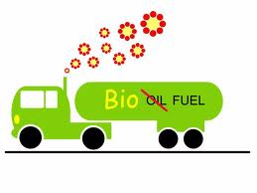
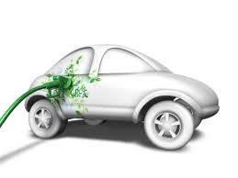
IMPLEMENTATION ISSUES
Identification of wasteland/degraded land for cultivation of plants bearing non-edible oilseeds
Inadequate supplies of feedstock in India
Commercial production of biodiesel in India is very small and its utilization is mostly confined to the unorganized sector; Advanced bio fuels in India still at the research stage
Modification in engines of automotive vehicle to make compatible for Bio fuels
Higher taxes and levies in different states have impacted the Ethanol Blending Program
Lack of high-yielding, drought-tolerant jatropha seeds
Smaller land holdings, ownership issues with government or community owned wastelands, and little progress made by state governments to meet large scale jatropha plantations

Slide 13
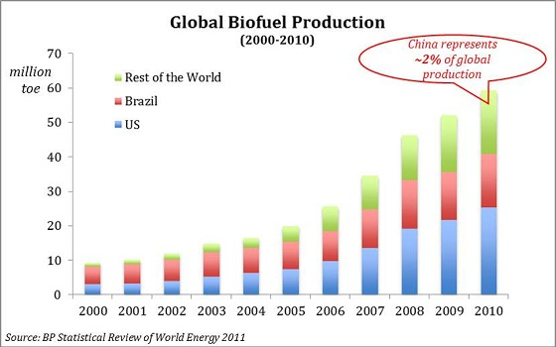
INTERNATIONAL SCENARIO
USA & Brazil account for 80% of total Biofuel production, mainly bio-ethanol
EU accounts for about 90% of world’s biodiesel output.
USA is the world’s largest consumer of Biofuels
Biofuels provide 2.7% of worlds’ fuels for road transport
31 countries mandate blending biofuels
Present Status

Slide 14
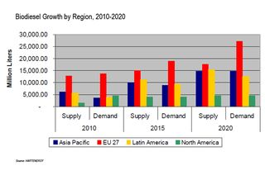
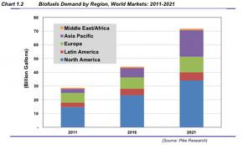
INTERNATIONAL SCENARIO
Estimate
IEA –potential to meet 5% of total road transport fuel demand by 2030
IEA – to meet 13% of total transport fuel demand and contributes to about 6% of global emission reductions by 2050.
Emerging markets – India, China, Indonesia, Malaysia, Argentina
Brazil Biofuel Policy: 1975
USA Biofuel Policy: 1992
Indonesia Biofuel Policy: 2009
Biofuel demand by regions 2011-20
Biodiesel growth by region 2010-20

Slide 15
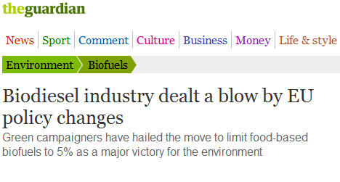
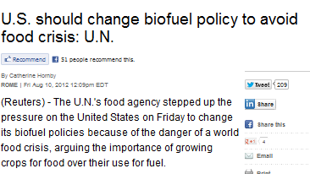

INTERNATIONAL SCENARIO
LATEST NEWS

Slide 16
RECOMMENDATIONS ( On existing policies )
On existing policies :
The provision of contract farming will lead to corporatization of plantation which will be detrimental to the interests of marginal farmers and growers.
MSP must be at per with the other agricultural items (in fact initially should be more lucrative to the farmers ) ;
We need to focus on states where the pollution is maximum ;
More strictness on the execution portion ;
Cultivation of plants bearing non edible oil should be done on uncultivable wasteland ( In India conventionally wasteland is any land which is unoccupied, undeveloped or unutilized)

Slide 17
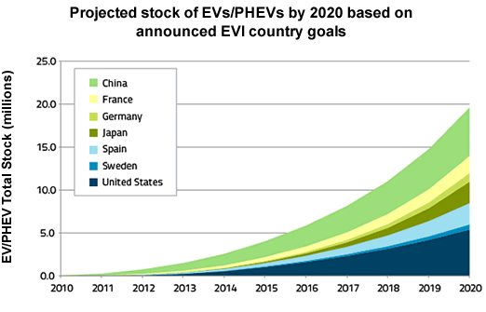
RECOMMENDATIONS ( Alternative Policies)
Electronic Vehicles (EV):
Vehicles having zero emission ;
20 million EV’s by 2020 ;
EV’s of India :Mahindra REVAi , Indica Vista

Slide 18
CONCLUDING REMARKS
Energy is a critical input for socio-economic development
There is a need to enhance the feedstock storage.
Conflict with food security
Carbon footprint.
Co Operative action between different stake holders.
The main challenge for the future is to develop biofuels which do not compete with the food chain, which are sustainable and efficient both in terms of costs and energy, and for which the carbon footprint is a net gain.

Slide 19
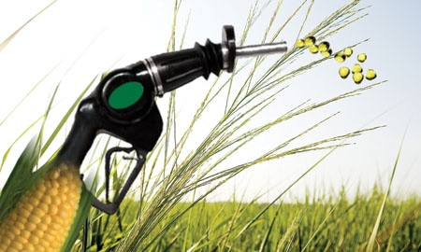
THANK YOU

